Slide 1




28th NA-MIC Project Week
June 25-29, 2018
Universidad de Las Palmas de Gran Canaria
Canary Islands – Spain
https://na-mic.github.io/ProjectWeek/PW28_2018_GranCanaria/
Prof. Juan Ruiz-Alzola
Universidad de Las Palmas de Gran Canaria
Instituto de Astrofísica de Canarias
INTERREG MACBioIDi PI
http://medtec4susdev.org

Slide 2


Key facts about ULPGC
Gran Canaria / Canary Islands are main global tourism destinations
Population: 0.9M / 2.1M
Tourists: 4.2M / 15M (13M foreign)
Part of Spain / European Union
Close to Africa: outermost region
Special regime / fiscal incentives
Well-connected / European standards
Two large universities / world-class research infrastr. Astrophysics - Oceanic
University of Las Palmas de Gran Canaria (ULPGC)
23.000 students / 1.600 faculty members
15 schools / 40 degrees / 33 masters / 13 PhD progr.
11 research institutes
Collaboration with many European & international universities and research centers
Cooperation for develop. -> Africa and Latin America
Las Palmas de Gran Canaria: large booming city
Metro area > 0.5M / large port & trade activity

Slide 3
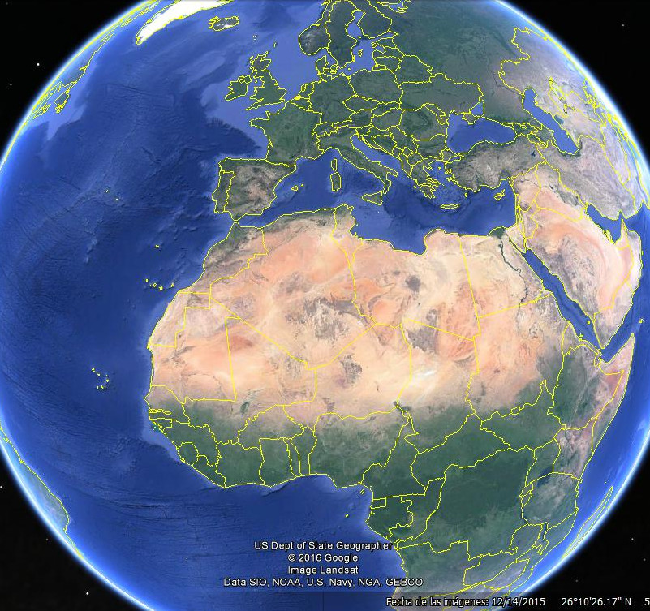
Gran Canaria:
Agadir: 600 km
Rabat: 1000 km
Nuakchot: 1100km
Dakar: 1500 km
Praia: 1700 km
Bamako: 1900 km
Conakry: 2000 km
FreeTown: 2200km
Niamey: 2400km
Monrovia: 2500 km
Yamusukru: 2600km
Acra: 3000 km
Abuja: 3200 km
Yaunde: 4000 km
Gran Canaria:
Madrid: 1700 km
Barcelona: 2200 km
Paris: 2700 km
London: 2900 km
Brussels: 3000 km
Rome: 3000 km
Amsterdam: 3200 km
Berlin: 3600 km
Helsinki: 4700 km
Cayenne: 4700 km
Azores
Madeira
MACARONESIA
Canary Islands
Cape Verde
Mauritania
Senegal
Notes:
Niamey: Níger
Yamusukru: Costa de MArfil

Slide 4
Strategic base for humanitarian aid
One of the five humanitarian logistic centers
One of the six overseas warehouses

Slide 5
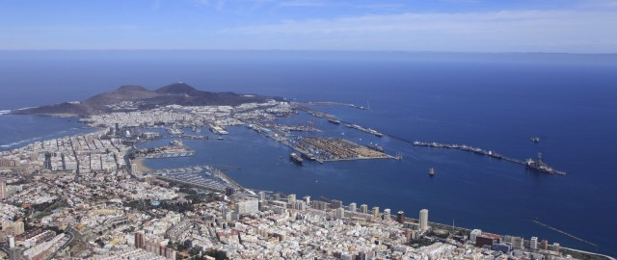
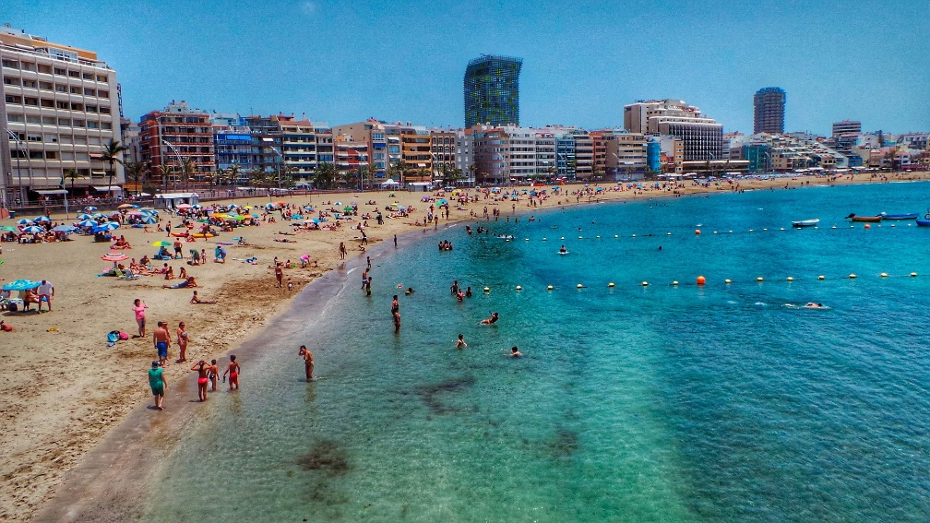
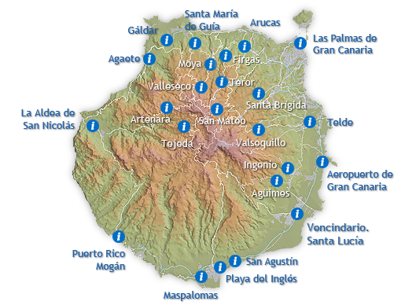
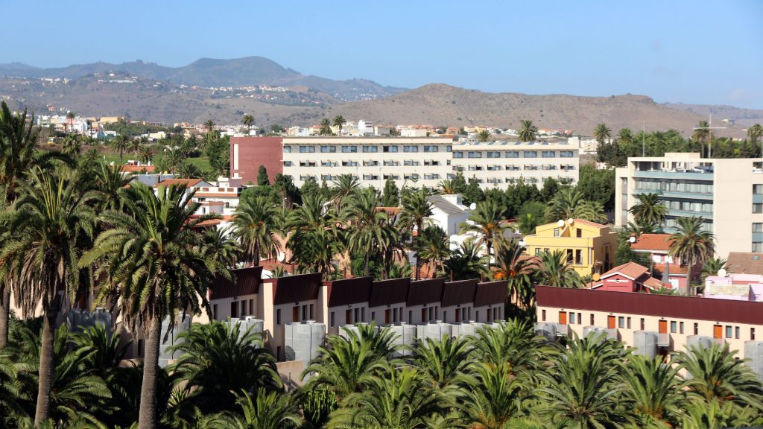
City of Las Palmas GC - harbor
City of Las Palmas GC –
Beach of Las Canteras
ULPGC main campus in Tafira
(Las Palmas GC)
http://www.grancanaria.com/turismo/en/

Slide 6
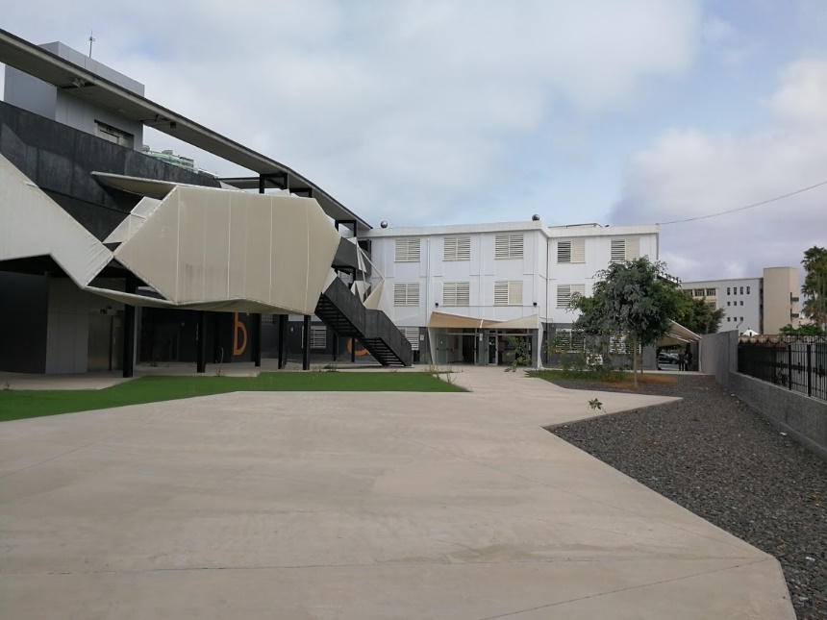
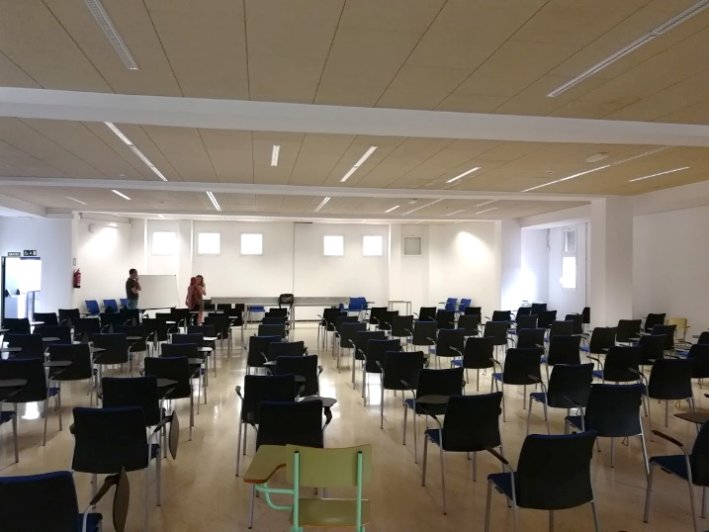
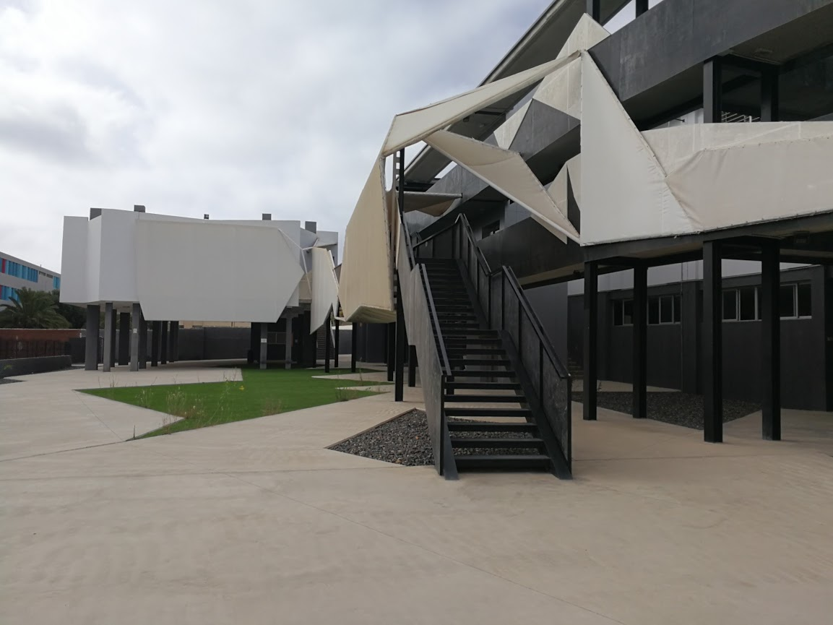
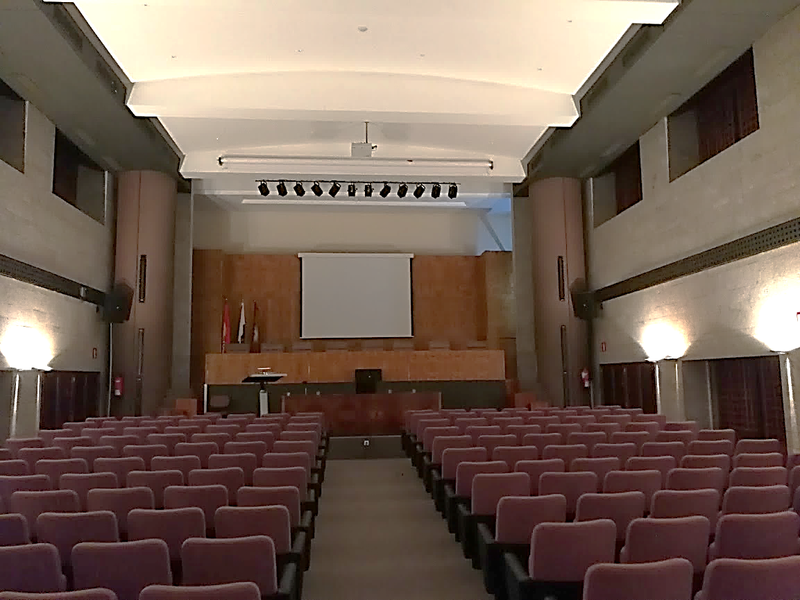
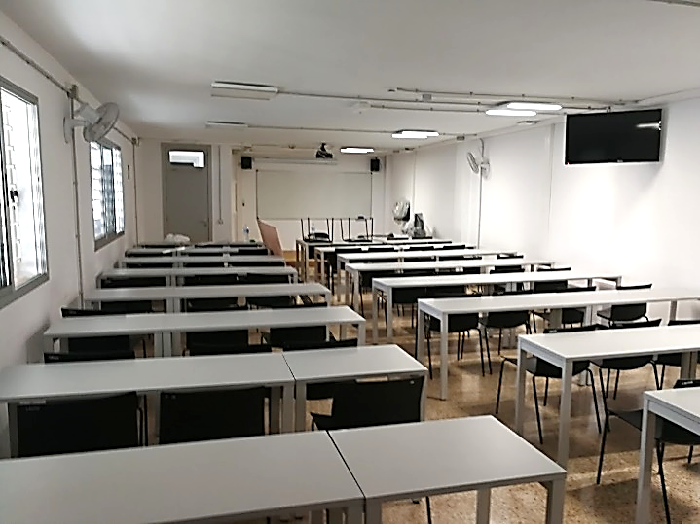
NA-MIC Venue at ULPGC

Slide 7
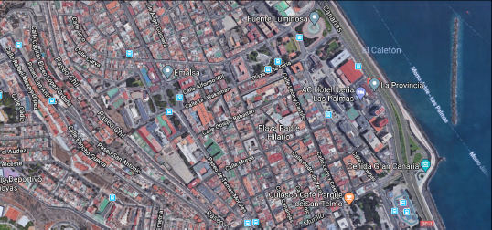
NA-MIC Venue at ULPGC
Hotel Marriot
AC beria
Aprox 100€/night
50 rooms reserved
Breakfast included
Hotel Parque
Approx 55€/night
40 romos reserved
Breakfast included
Reserved until
March 30
Hotel Marriot
AC Iberia
1 Km
12 min.
Hotel Parque
1.1 Km
13 min.
Google Maps – Data Inst Geogr Nac
http://achotels.marriott.com/hotels/ac-hotel-iberia-las-palmas
http://hotelparqueenlaspalmas.com/en/
NA-MIC venue

Slide 8
Exploring potential synergies to apply NA-MIC technology in developing countries
Our concept: medical technology for sustainable development
Our logo is devised to visually convey this concept
Already working in Cape Verde, Mauritania and Senegal. Soon Mozambique
Our website: http://medtec4susdev.org
Our motto: train the trainers - affordable high-tech for sustainable development
During NA-MIC Project Week we’ll host a parallel event with some of our African partners (physicians, engineers and academics) to introduce them to NA-MIC technology and explore synergies

Slide 9
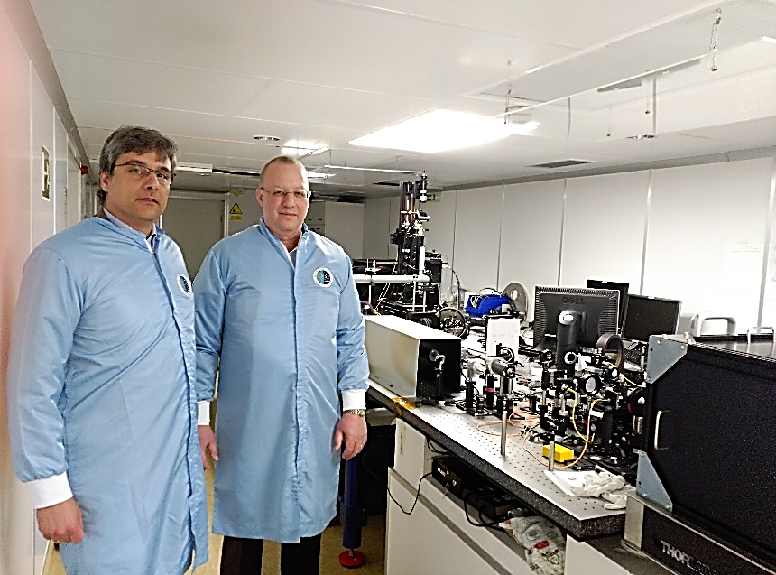
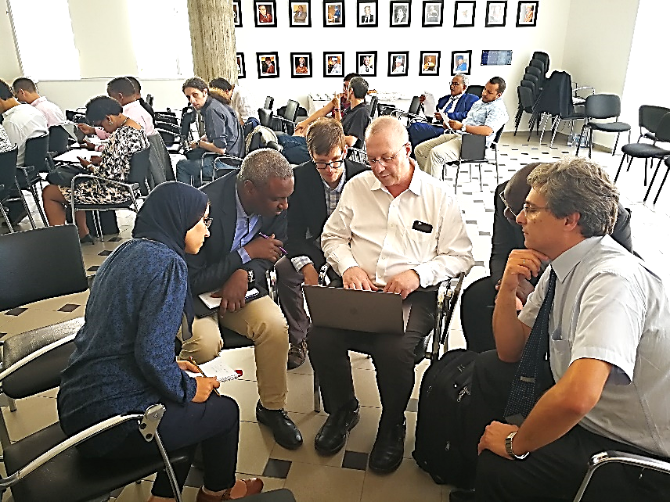
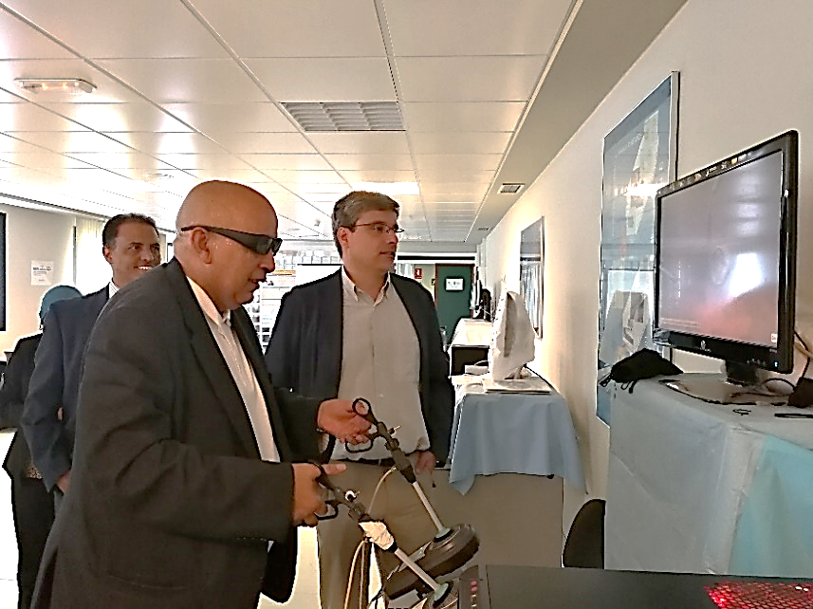
Already started & promoting international collaboration
In the Canary Islands
Only a first step. Some of the next ones:
International mentoring
Medical & engineering education based on technology
Affordable high-tech medical & surgical simulators
Screening the diabetic foot measuring thermal radiation

Slide 10
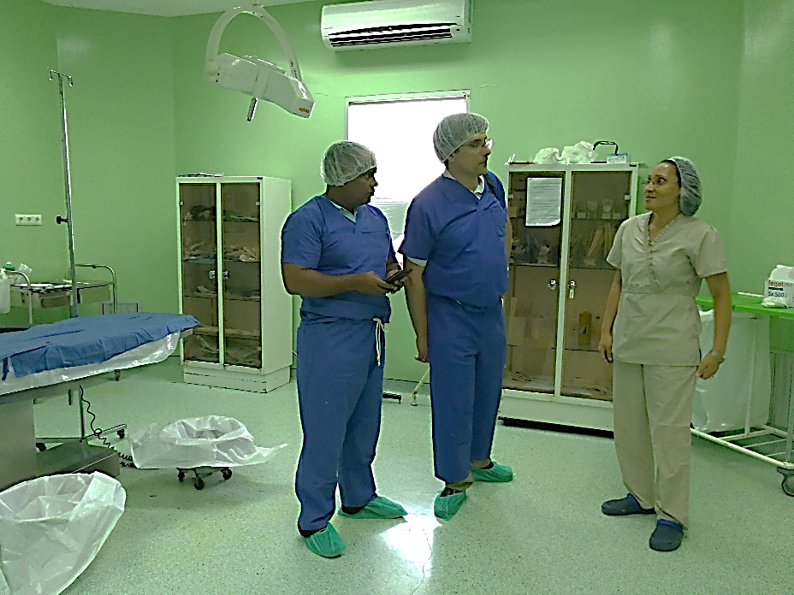
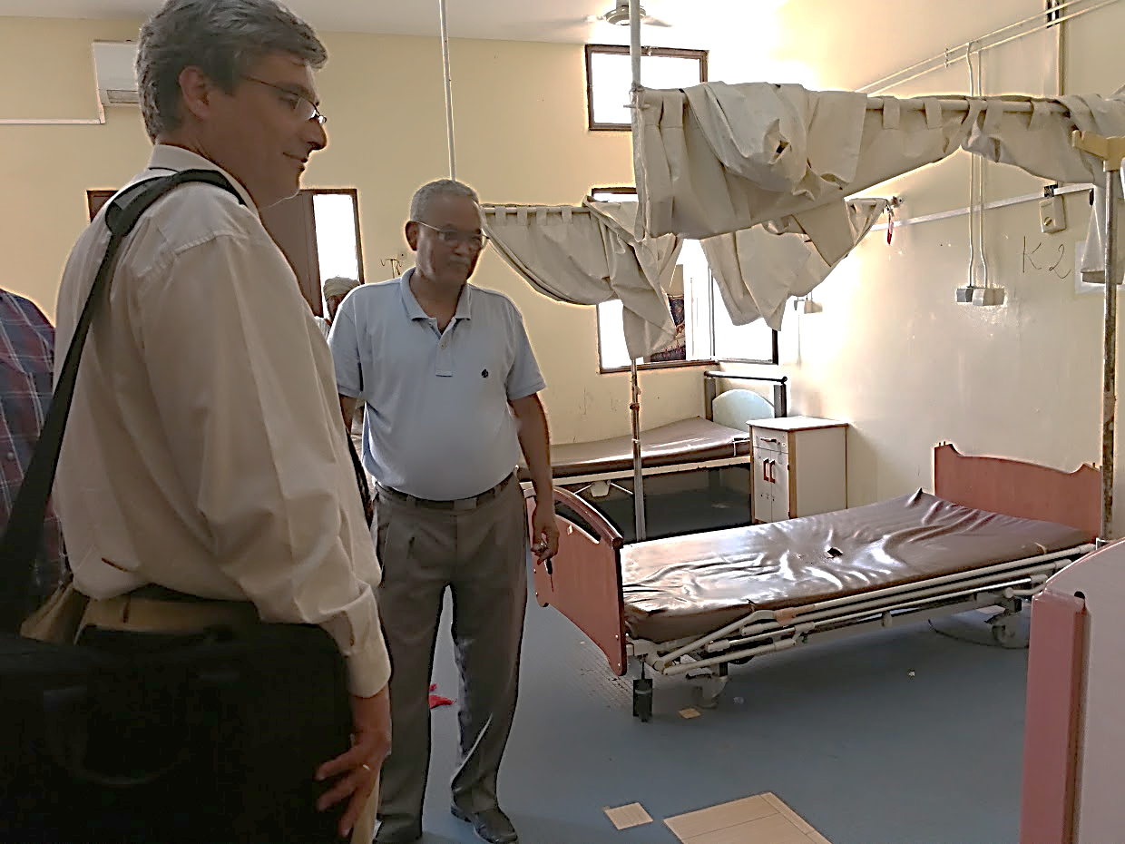
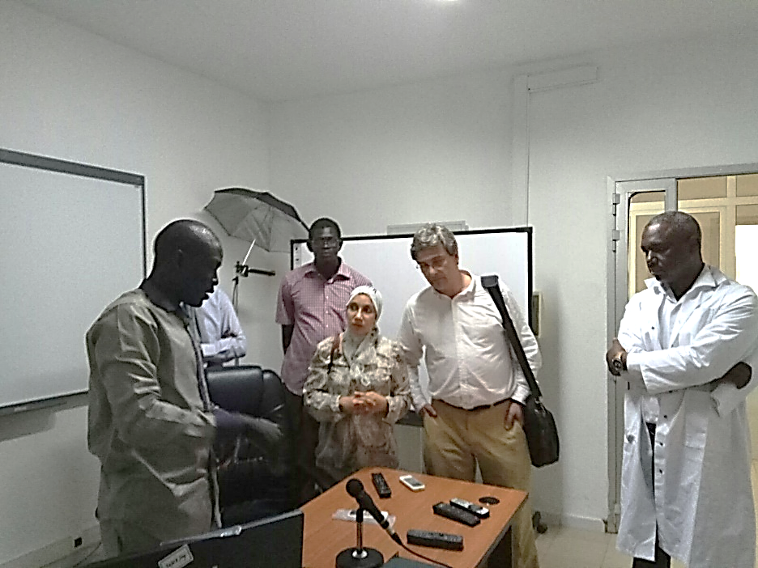
Already started & promoting international collaboration
In Cape Verde, in Mauritania, in Senegal
Only a first step. Some of the next ones:
International mentoring
Medical & engineering education based on technology
Affordable high-tech medical & surgical simulators
Screening the diabetic foot measuring thermal radiation

Slide 11
Looking forward, looking further
An international hub for medical technology and training, adapted to the needs of developing countries, which serves as model of reference
Train the trainers based on technology: health personnel & engineers
Develop technology paradigms well suited to the needs: medical virtual simulators, autonomous telemedicine systems, hospital information systems
Mainly using open technology licensing schemes: promote innovative business models that foster local economy during deployment
Integrate into a global network all the partners

Slide 12
Thank you and see you soon in Gran Canaria!!!
Prof. Juan Ruiz Alzola
Universidad de Las Palmas de Gran Canaria & Instituto de Astrofísica de Canarias
INTERREG MACBioIDi PI
http://medtec4susdev.org

